Slide 1
CAPTCHA detection with machine learning and computer vision
MC906/MO416 – Final Project

Slide 2
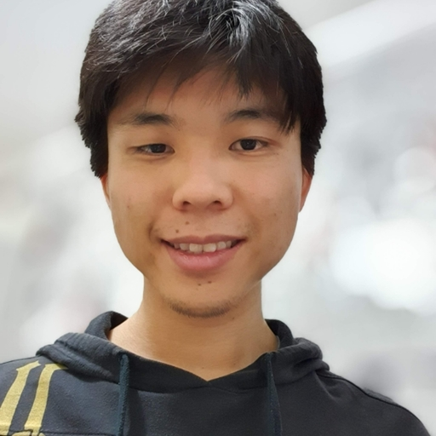
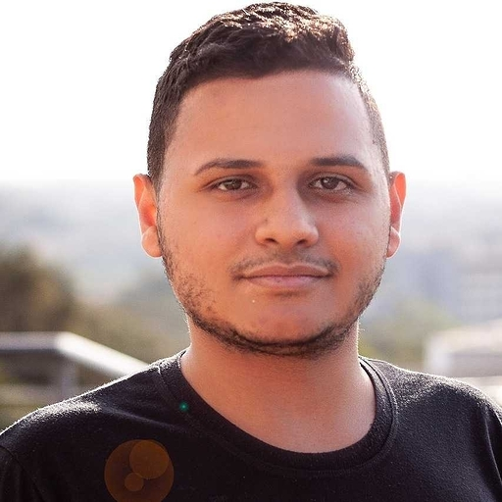


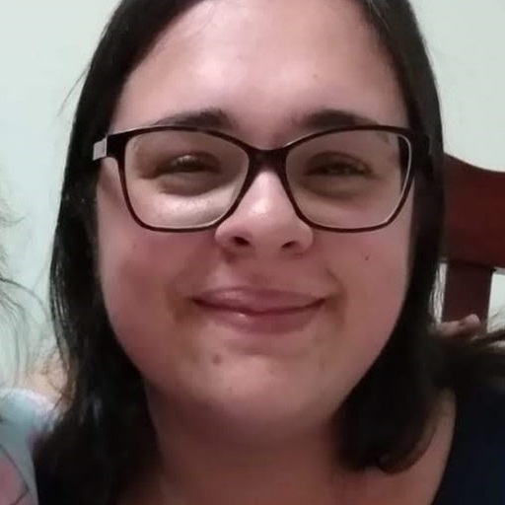
Team
Christian Maekawa
RA - 231867
Giovane de Morais
RA - 192683
Matteus Vargas
RA- 262885
Maísa Silva
RA - 181831
Stéfani Fernandes
RA - 147939

Slide 3
Schedule
Introduction
Concepts
Methodology
Tests
Results
Conclusion

Slide 4
1.
Introduction
Problem and how to solve?

Slide 5
CAPTCHA
Completely Automated Public Turing test to tell Computers and Humans Apart

Slide 6


Introduction
CAPTCHA: distinguish a human from robots;
Using images and sounds
Common use in security system
Study: Decode CAPTCHAS from images
Using Machine Learning

Slide 7
2.
concepts
Theoretical basis

Slide 8
Concepts
Machine Learning
Supervised
Classification
Computer Vision
Convolutional Neural Networks (CNN)
Activation Function
ReLU
Softmax
Sigmoid
Optimization
Adam
SGD
Regularization
Dropout
Metrics
Cross-Entropy classification
Accuracy
Confusion Matrix
Tools
Tensorflow
Keras
OpenCV
Scikit-learn

Slide 9
3.
Methodology
What was done and how?

Slide 10
Methodology
Datasets generation
Pre
processing
Training and
Evaluating
Testing

Slide 11
Methodology
Dataset generation
Random
99910 images
Permutation
100029 images
Test
19976 images
Pre-processing
OpenCV
Resize 60x160 to 30x80
Grayscale
Scaling diving by 255
Notes:
Gerador de captcha é de uma biblioteca https://github.com/lepture/captcha por favor citar ele
Pra usar ele você baixa com pip install captcha

Slide 12
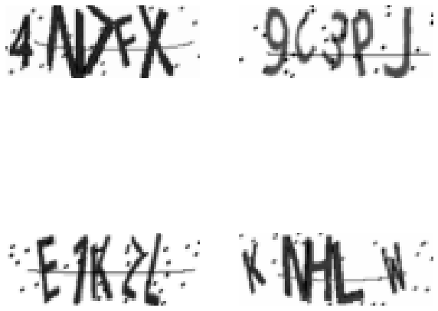
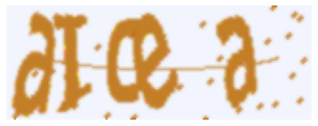
Pre-Processing
Processed image
Original image
Notes:
?

Slide 13
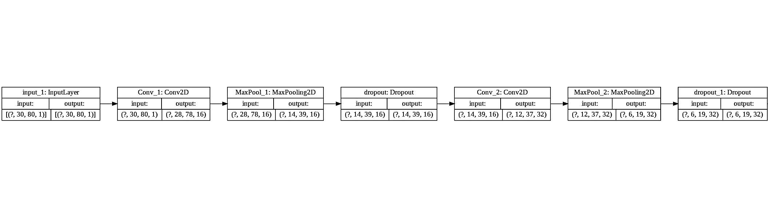
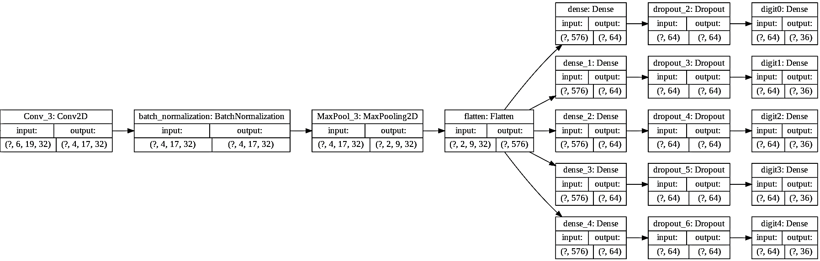
convolutional neural network

Slide 14
Methodology
Neural Network CNN Layers
Input: Instantiation, image shape
Three Convolutional layers: ReLU + kernel initalization + no padding
First layer: 16 filters
Second and third: 32 filters
Three pooling layers: reduce data representation (Maxpooling)
Dropout layers: 0.1, 0.2 and 0.5
Batch normalization: normalize activation
Flatten: flat the next input
Dense: fully connected layer with five outputs. Sigmoid function
Compilation: Adam; Accuracy metric

Slide 15
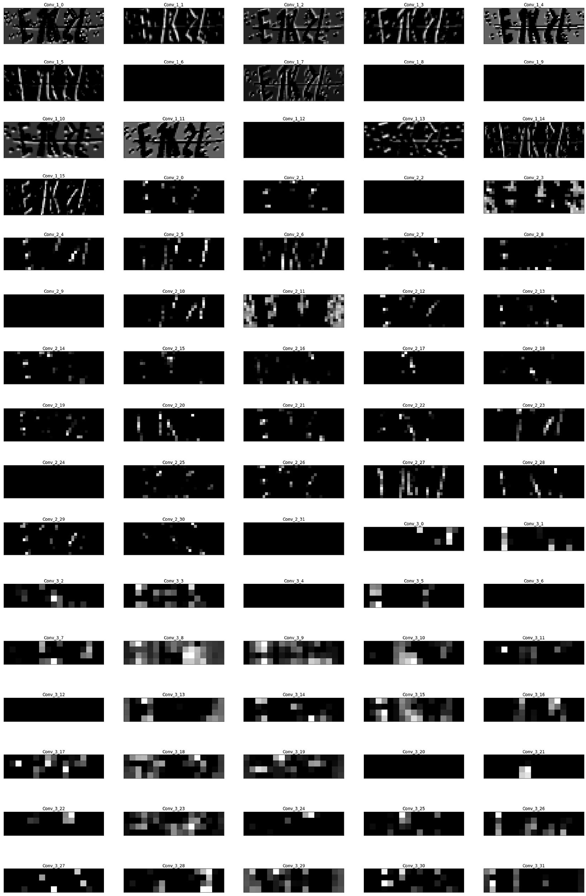
Output from convolutional 2d and Max Pulling

Slide 16
Methodology
Training: Baseline
Epochs: 500
Batch Size: 1000
Validation Split: 0.2
Callbacks:
Early stopping: 200 patience

Slide 17
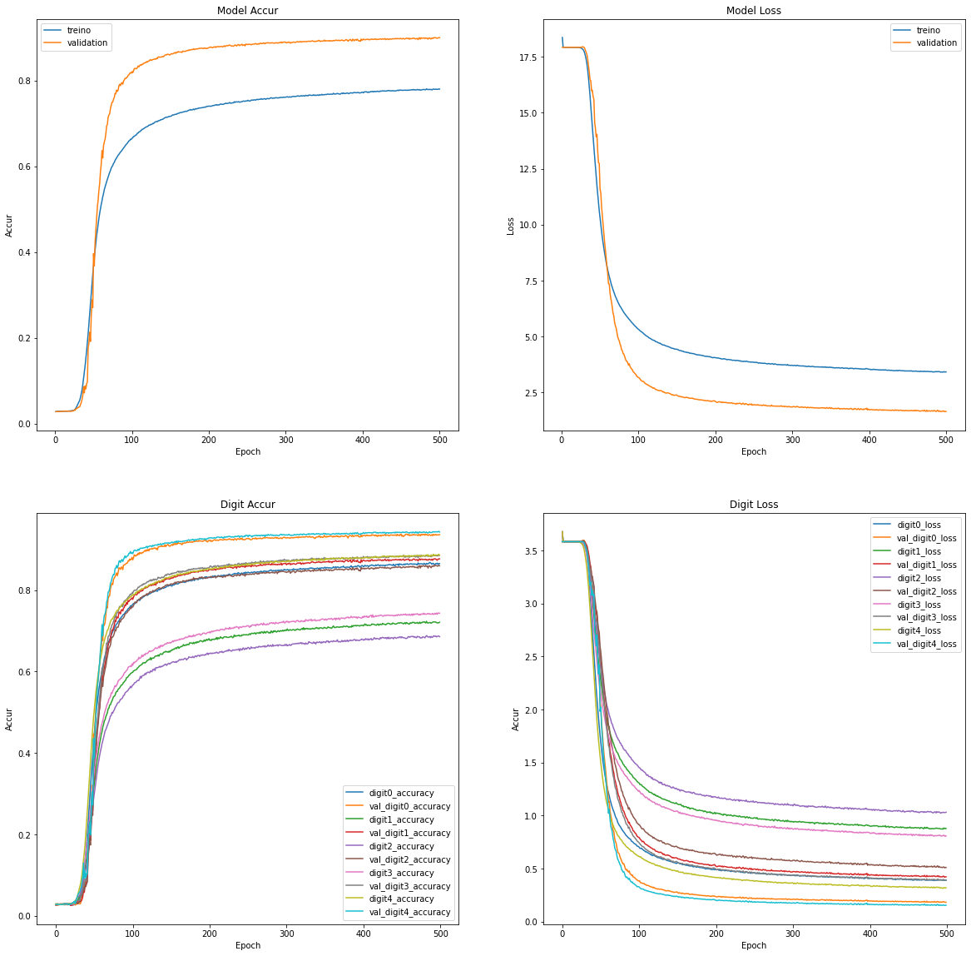
Random dataset

Slide 18
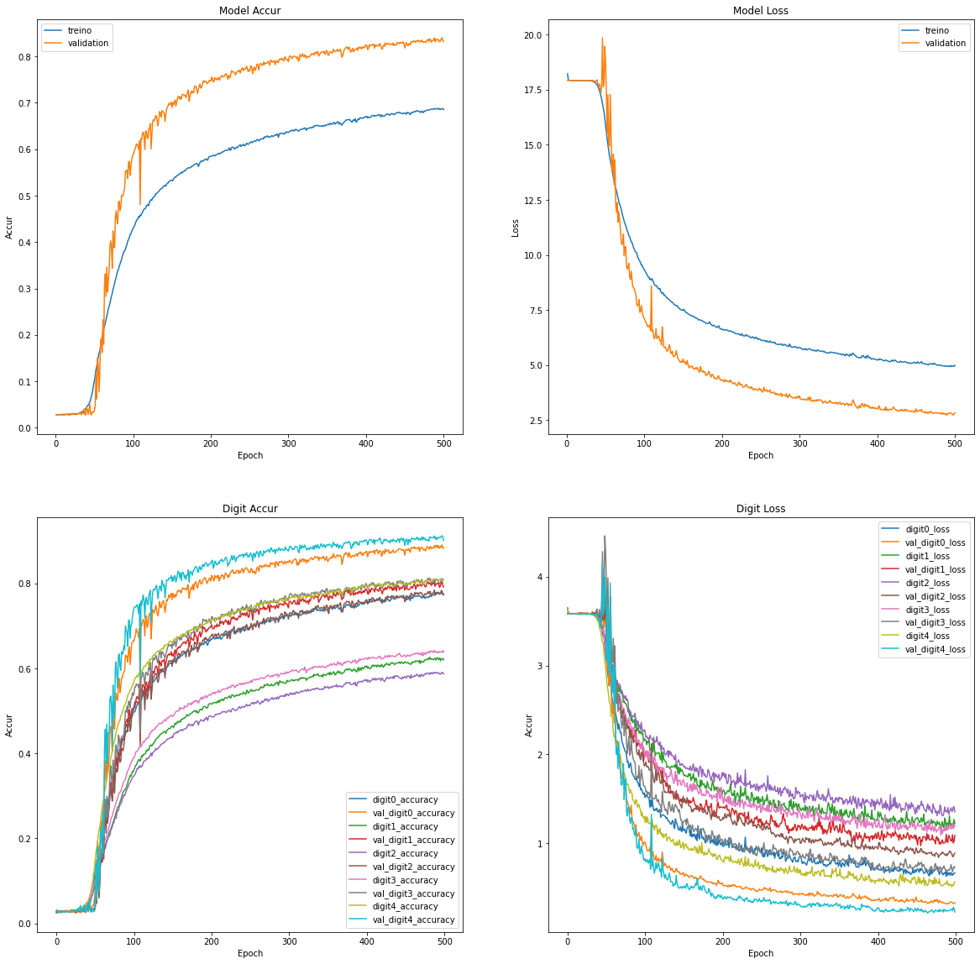
Permutation
dataset

Slide 19
4.
Tests
Let’s evaluate the solution and its possibilities

Slide 20
Tests
Google Colaboratory
Questions:
Are there better scenarios?
If varying hyperparameters influences the final result?
Do datasets influence?
What is the role of dropout?
Determine the best combination and its scenario

Slide 21
Baseline Test
Digit | Random | Permutation
1 | 0.94 | 0.88
2 | 0.88 | 0.80
3 | 0.86 | 0.77
4 | 0.88 | 0.81
5 | 0.94 | 0.90
Total | 0.90 | 0.83

Slide 22
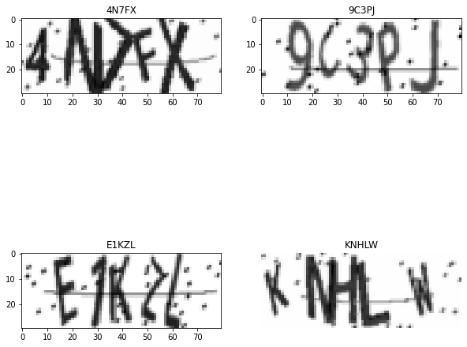
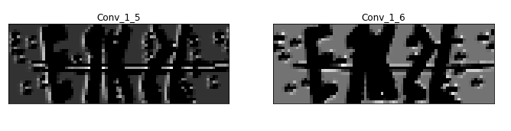


Slide 23
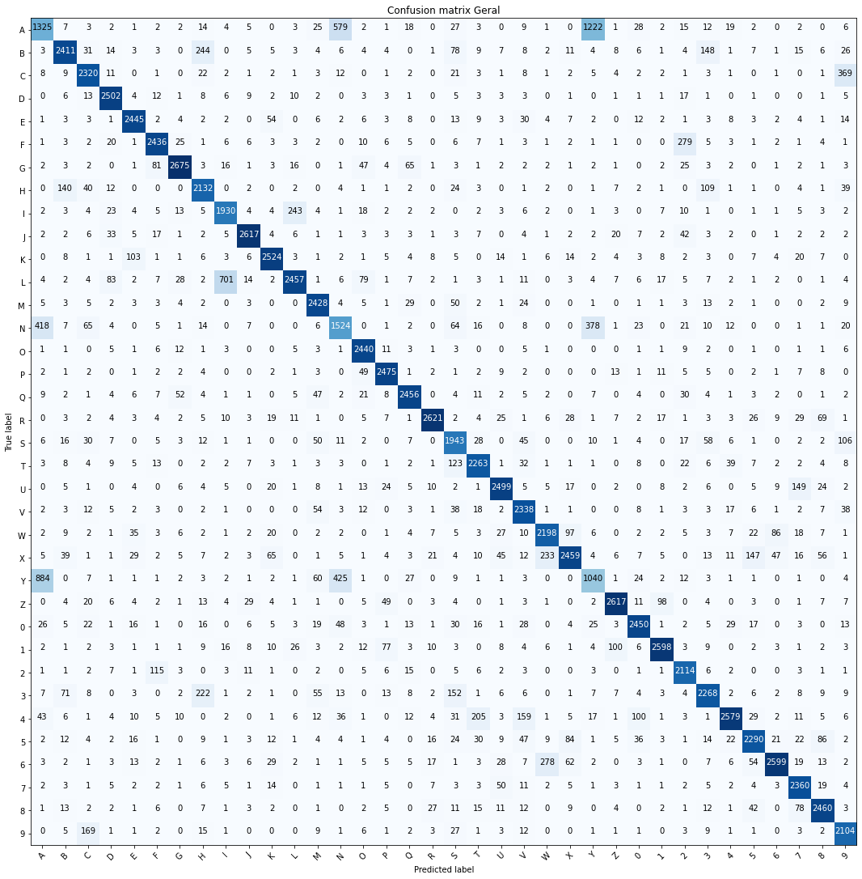

Slide 24
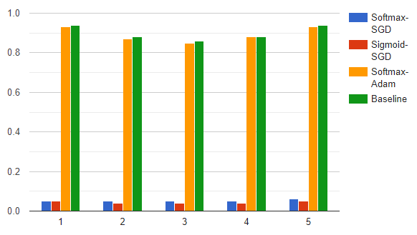
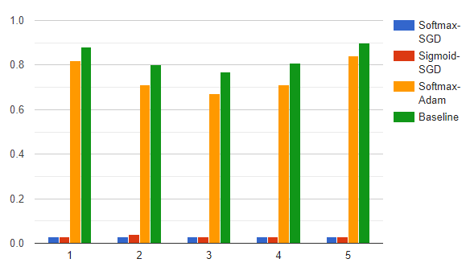
Activation + Optimizer

Slide 25
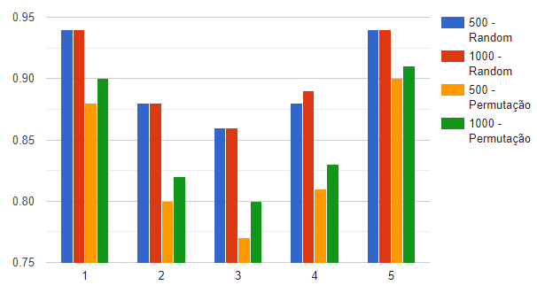
Changing epoch parameters

Slide 26
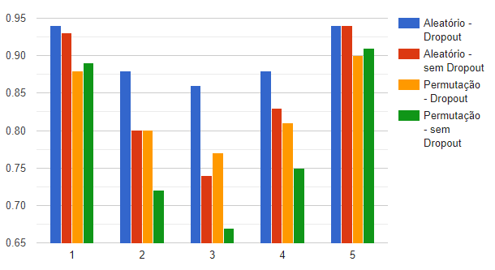
dropout

Slide 27
4.
Results
Let’s evaluate the solution and its possibilities

Slide 28
Results
The baseline proved to be very good for the random dataset and good for the permutation
Adam best than SGD with baseline variation
Permutation needs more epochs: from 83% to 85%
Edge characters have high accuracy than mid characters
Permutation dataset have best generalization
Significant variables:
Number of filter + Epochs + Sigmoid + Adam +Dropout

Slide 29
Comparing with literature
Reference | Accuracy
Wei et al. | 98.43% / 1580 letter
Noury et al. | 98.3% / 500k images
Goodfellow | 97.4% / 200k images
Yu et al. | 92.37% / 16,000 images
Proposal | 90% (random)/85%(permutation) 99k images / 100k

Slide 30
References
L. Wei, X. Li, T. Cao, Q. Zhang, L. Zhou, and W. Wang, “Research on optimization of captcha recognition algorithm based on svm,” in Proceedings of the 2019 11th International Conference on Machine Learning and Computing, 2019, pp. 236–240.
Noury and M. Rezaei, “Deep-captcha: a deep learning based captcha solver for vulnerability assessment,” arXiv preprint arXiv:2006.08296,2020.
J. Goodfellow, Y. Bulatov, J. Ibarz, S. Arnoud, and V. Shet, “Multi-digit number recognition from street view imagery using deep convolutional neural networks,”arXiv preprint arXiv:1312.6082, 2013.
N. Yu and K. Darling, “A low-cost approach to crack python captchas using ai-based chosen-plaintext attack,” Applied Sciences, vol. 9, no. 10,p. 2010, 2019

Slide 31
Thanks!
Any questions?

